Slide 1

Parallel Algorithm for Constructing Independent Spanning Trees in Bubble-Sort Networks
Members:
Malaika Afzal 22i-0885
Fatima 22i-1074
Mustafa Kamran 22i-1013

Slide 2





Agenda
Introduction to Independent Spanning Trees and Bubble-Sort Networks
Algorithm Description and Parallelization
Correctness and Complexity Analysis
Height Analysis of Constructed Trees
Conclusions and Future Work

Slide 3
Introduction: Independent Spanning Trees and Bubble-Sort Networks
Bubble-Sort Networks Bn
Independent Spanning Trees (ISTs)
It is a subclass of Cayley graph.
ISTs provide fault-tolerance and secure multi-path data broadcasting in networks.
Cayley graphs have been used extensively to design the topologies of interconnection networks, construction of ISTs on Cayley graphs is significative.
ISTs ensure vertex- and edge-disjoint paths from any vertex to a common root.
Vertices represent permutations; edges represent adjacent swaps.
Disjoint paths allow recovery if a path fails.
Ensures secure multi-path communication, as each node only gets a portion of the data.

Slide 4
Context
Context: Efficient and reliable communication in interconnection networks is critical for parallel computing.
IST, are a powerful tool for this. They provide multiple,
disjoint paths from any node back to a root, offering
fault tolerance
security benefits."

Slide 5
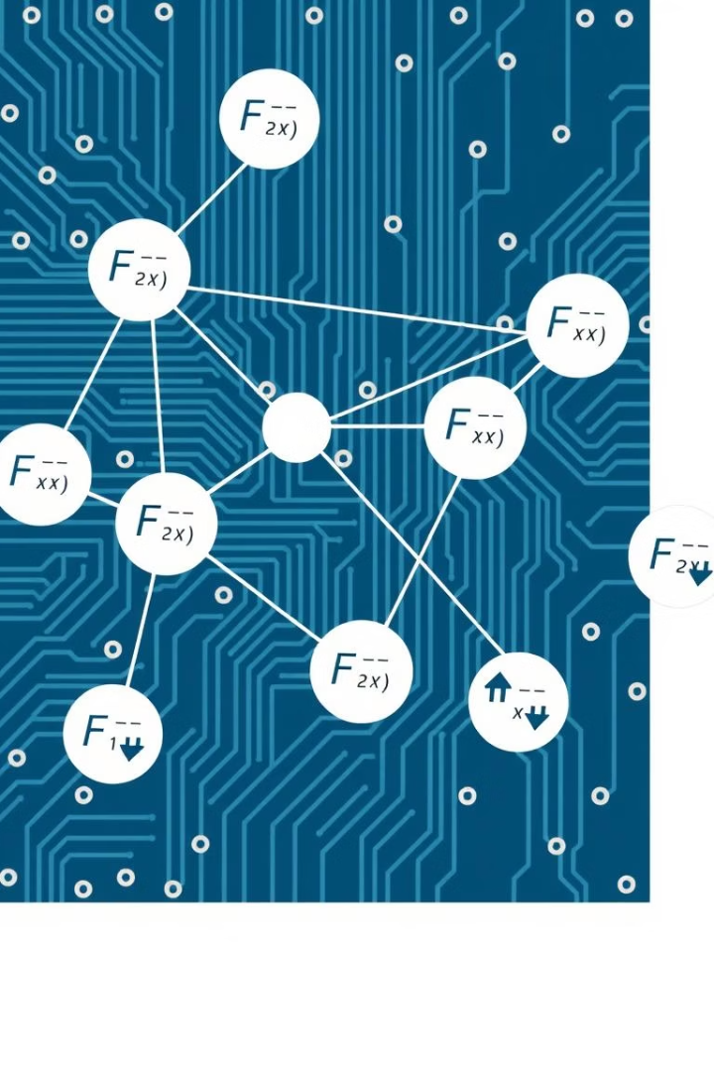
Constructing ISTs on Bubble-Sort Networks
Problem Addressed
Time Complexity
Previous IST construction used a recursive algorithm, which limited parallelization.
O (n*n!), where n is dimension and n! is no. of vertices of network.
Network Properties
Connectivity: n-1 Diameter: D(u,v) = max distance from u to v d(u,v) = shortest distance from u to v.

Slide 6
Papers Solution: Key Contributions
A non-recursive method to determine the parent of any vertex v in any of the ISTs
Key Claim: The algorithm is "fully parallelized".
Each vertex v can compute its parent in any tree independently of all other vertices.
Parent calculation takes constant time, assuming O(n) pre-processing per vertex.
Result: Optimal total time complexity of O(n * n!) to construct all parent pointers for all n-1 trees (matches the lower bound).

Slide 7
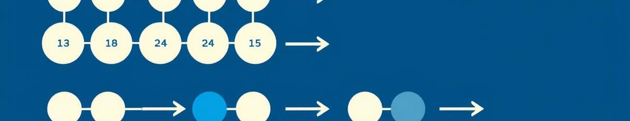
Parallel Algorithm for IST Construction
1
Algorithm Overview
2
Key Concept
3
Algorithm Steps
Non-recursive, fully parallelizable method for constructing n−1 ISTs on Bn.
Each vertex computes parent in constant time for each IST.
Uses functions FindPosition and Swap to determine parents efficiently.

Slide 8
Parent Determination Algorithm: Rules and Functions
1
Parent1(v,t,n) Function
2
FindPosition(v) Function
3
Swap(v,x) Function
The main function that determines the parent of vertex v in the t-th tree of dimension n. It handles different cases based on the last symbol of v and applies specific rules accordingly.
A helper function that finds the appropriate position for swapping symbols in vertex v based on three conditions related to the structure of v and the tree index t.
A simple function that swaps the symbol x in vertex v with its immediately succeeding symbol.

Slide 9
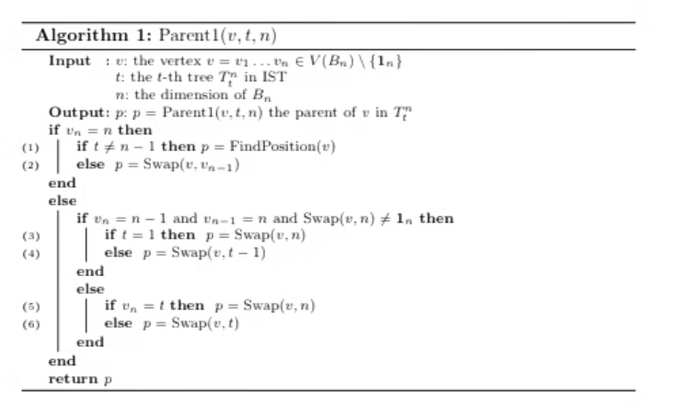
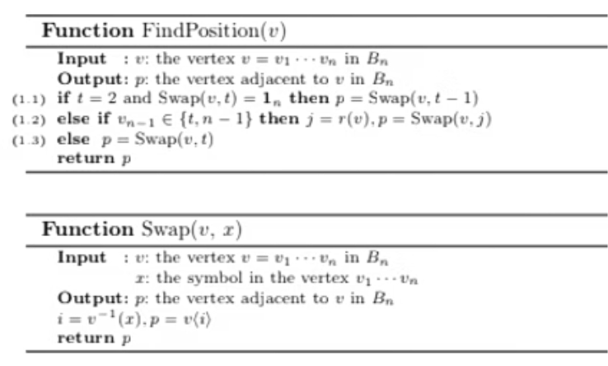
Proposed Parallel Algorithm
Total 6 Rules
Example: T (543216, t=1,n=6) = (453216, 435216, 432516, 432156, 342156, 324156, 321456, 231456, 213456, 123456)

Slide 10
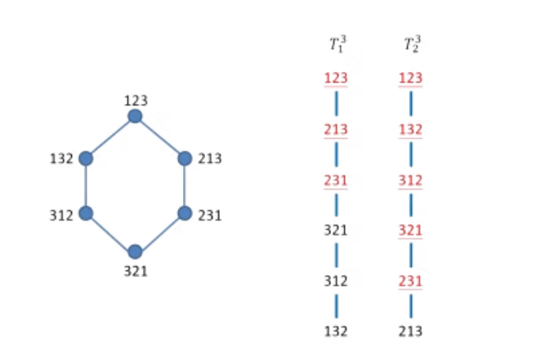
Constructing ISTs on B3
Case of n=3
The identity 1n=12…n can be chosen as the common root r for all ISTs.
No. of vertices: n! = 3! = 6
No. of trees = n-1 = 3-1 = 2
T1​=(123,213,231,321,312,132), t=1
T2=(123,132,312,321,231,213), t=2

Slide 11
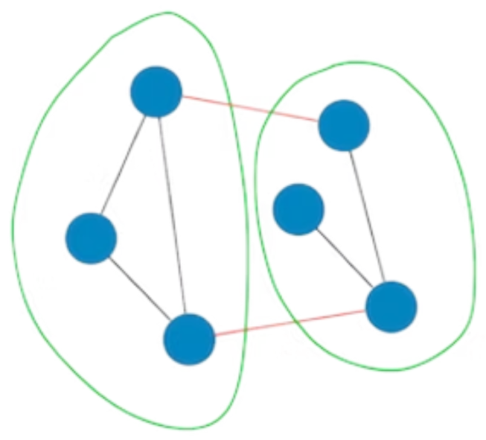
Graph Partitioning with METIS
Represent the bubble-sort graph in METIS format.
Request k partitions equal to MPI process count.
Apply vertex-based partitioning to assign nodes to partitions.
Ensure partitions are balanced to evenly distribute workload.

Slide 12
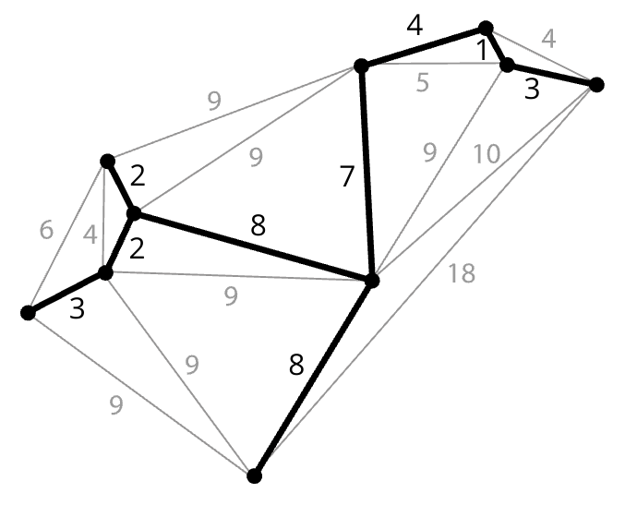
OpenMP Implementation Details
Each MPI process handles one subgraph.
Use OpenMP to compute local ISTs (Independent Spanning Trees) in parallel
Parallel parent assignment for all nodes in the subgraph
Communicates with other processes for border vertices using MPI_Send/MPI_Recv

Slide 13
MPI Implementation Details
Communicate across boundary nodes between subgraphs
Synchronize root paths and update parent info
Use MPI_Bcast, MPI_Send/Recv or MPI_Gather to coordinate results
Final Reconstruction
Merge all local ISTs and synchronized boundary data
Reconstruct the complete set of disjoint ISTs for the original bubble sort graph

Slide 14
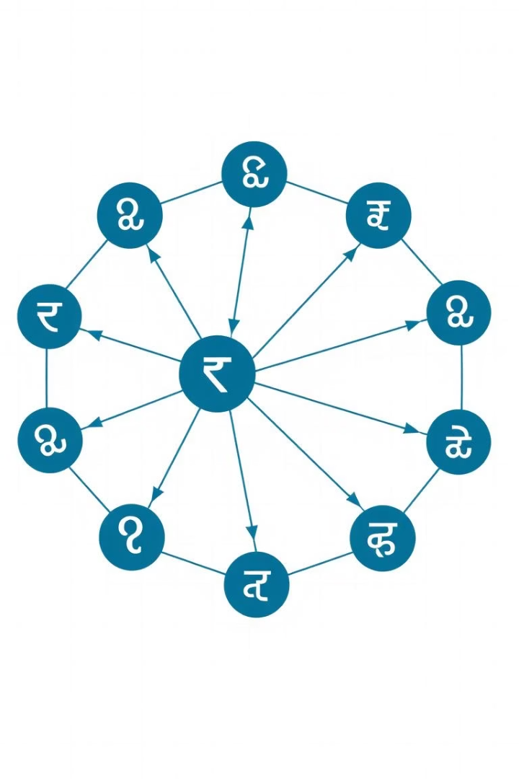
Correctness and Optimal Complexity
Correctness Proof
Complexity Bound
Paths from each vertex to root are unique and vertex-disjoint across ISTs.
Total computation time is O(n · n!), matching theoretical lower bound.
Independence
These paths are disjoint across trees because:
Each tree focuses on a different "fixing" strategy via t
The swap sequence and the positions involved don’t overlap with those from another tree.

Slide 15
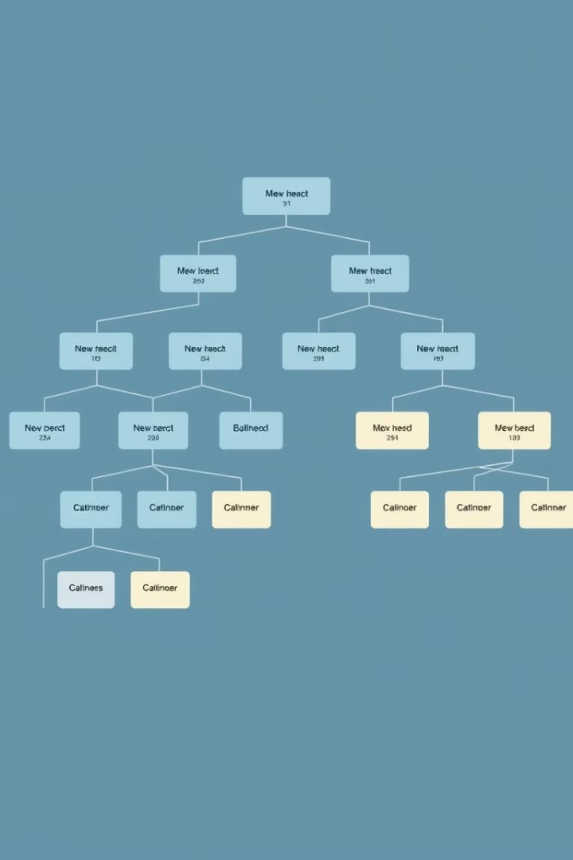
Height Analysis of Constructed ISTs
Height Bound
Diameter
Height Hn ≤ D(Bn) + n − 1 where D is the network diameter.
Diameter D(Bn) = n(n − 1)/2.
Interpretation
Constructed ISTs have near-optimal heights relative to network size.

Slide 16

Conclusions and Future Directions
Butterfly Graph Properties:
(n, k) Bubble-Sort Graphs: Have partial permutations.
Structural symmetries and regular degree of 4.
Conclusions
Recursive construction properties similar to bubble-sort networks.
Proposed Algorithm: The paper proposes an algorithm for constructing n−1 ISTs rooted at any arbitrary vertex in Bn.
These partial permutations complicate the construction of ISTs, requiring the algorithm to account for the new constraints in the spanning tree construction.
Routing Constraints:
Fully parallelizable
The hierarchical structure may limit which paths can be used.
Time Complexity: O(n.n!)
Constructs the maximum possible number of ISTs.

Slide 17
References & Acknowledgments
The algorithm and analysis build upon foundational work in graph theory and parallel algorithms.
Key references include Kao et al. (2019) and foundational texts on Cayley graphs and interconnection networks.
Supported by LaBRI, ANR project TEMPOGRAL, and the National Science and Technology Council of Taiwan.
Authors: Shih-Shun Kao, Ralf Klasing, Ling-Ju Hung, Chia-Wei Lee, Sun-Yuan Hsieh.

